Slide 1
Hierarchical Protein Structure Superposition
Using Both Secondary Structure and Atomic Representations
Amit P. Singh and Douglas L. Brutlag
Proc. Int. Conf. Intell. Syst. Mol. Biol. 5: 284–293, 1997
Presenter : Hsiao-Yen Chang
Date : July 11, 2007

Slide 2
Abstract
The structural comparison of proteins has become
increasingly important as a means to identify protein motifs
and fold families. In this paper we present a new algorithm
for the comparison of proteins based on a hierarchy of
structural representations, from the secondary structure
level to the atomic level. Our technique represents α-
helices and β-strands as vectors and uses a set of seven
scoring functions to compare pairs of vectors from different
proteins. The scores obtained are used in a dynamic
programming algorithm that finds the best local alignment
of the two sets of vectors.

Slide 3
Abstract (cont.)
The second step in our algorithm is based on the atomic
coordinates of the protein structures and improves the
initial vector alignment by iteratively minimizing the RMSD
between pairs of nearest atoms from the two proteins. We
refine the final alignment by determining a core of well
aligned atoms and minimizing the RMSD of this core. In a
comparison of our method to Holm and Sander’s DALI
algorithm, our program was able to detect structural
similarity at the same level as DALI. We also performed
searches of a representative set of the Protein Data Bank
(PDB) using our program and detected structurally
similarity between several distantly related proteins.

Slide 4
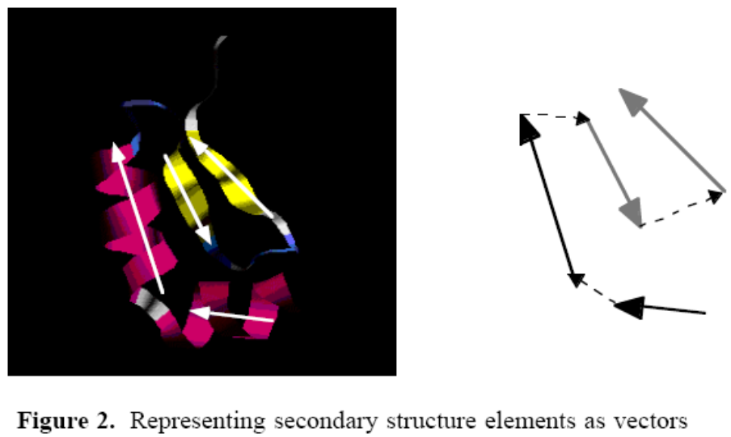
Methods
Step 1: Local Secondary Structure Superposition
  To obtain an initial structural superposition, we first represent each of the helices and strands in the two proteins as individual vectors.

Slide 5
Step 1 (cont.)
For a helix beginning at residue i and ending at residue j, the following equations are used to compute the beginning and end points of its representative vector:
X_{origin} = (0.74*X_{i} + X_{i+1} + X_{i+2} + 0.74*X_{i+3})/3.48
X_{end} = (0.74*X_{j} + X_{j-1} + X_{j-2} + 0.74*X_{j-3})/3.48
Similarly, the following equations are used to compute the beginning and end points of the representative vector for a strand starting at residue i and ending at residue j:
X_{origin} = (X_{i} + X_{i+1})/2
X_{end} = (X_{j} + X_{j-1})/2

Slide 6
Step 1 (cont.)
We implemented a dynamic programming algorithm, using the scoring functions (described below), to align the secondary structure vectors of the two proteins.
  Orientation Independent Scores :
S1 = S{|angle(i,k) - angle(p,r)|}
S2 = S{|angle(i,j) - angle(p,q)|}
S3 = S{|angle(j,k) - angle(q,r)|}
S4 = S{|distance(i,k) - distance(p,r)|}
S5 = S{|length(k) - length(r)|}
  Orientation Dependent Scores :
S6 = S{angle(k,r)}
S7 = S{distance(k,r)}

Slide 7
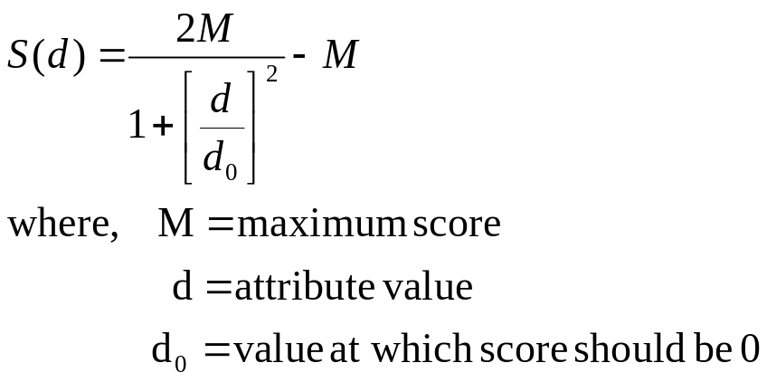
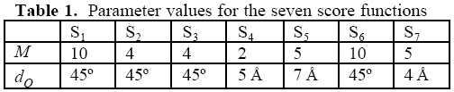
The function S is defined as follows (Gerstein and Levitt,1996):
These values were selected by iteratively modifying them and then testing the program with a chosen set protein pairs.

Slide 8
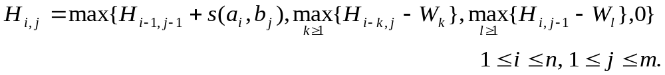
Step 1 (cont.)
We used a variation of the Smith-Waterman algorithm (Smith and Waterman, 1981) to find the best local alignment of the secondary structure vectors.
Smith-Waterman algorithm
  If a_{i} and b_{j} are associated, the similarity is H_{i,j} + s( a_{i},b_{j}) .
  If a_{i} is at the end of a deletion of length k, the similarity is H_{i-k, j} － W_{k} .
  If b_{j} is at the end of a deletion of length I , the similarity is H_{i-k, j} － W_{l} .
  W_{k} = 1+ 1/3*k (k=extent of gap)

Slide 9
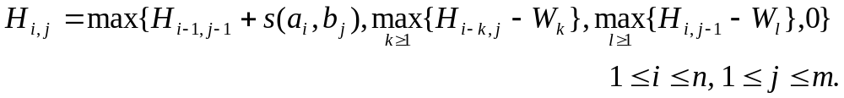
Example
Match +1 ; Mismatch -1/3 ; W_{k} = 1+1/3*k
 |  | C | A | G | C | C | U | C | G | C | U | U | A | G
 | 0.0 | 0.0 | 0.0 | 0.0 | 0.0 | 0.0 | 0.0 | 0.0 | 0.0 | 0.0 | 0.0 | 0.0 | 0.0 | 0.0
A | 0.0 | 0.0 | 1.0 | 0.0 | 0.0 | 0.0 | 0.0 | 0.0 | 0.0 | 0.0 | 0.0 | 0.0 | 1.0 | 0.0
A | 0.0 | 0.0 | 1.0 | 0.7 | 0.0 | 0.0 | 0.0 | 0.0 | 0.0 | 0.0 | 0.0 | 0.0 | 1.0 | 0.7
U | 0.0 | 0.0 | 0.0 | 0.7 | 0.3 | 0.0 | 1.0 | 0.0 | 0.0 | 0.0 | 1.0 | 1.0 | 0.0 | 0.7
G | 0.0 | 0.0 | 0.0 | 1.0 | 0.3 | 0.0 | 0.0 | 0.7 | 1.0 | 0.0 | 0.0 | 0.7 | 0.7 | 1.0
C | 0.0 | 1.0 | 0.0 | 0.0 | 2.0 | 1.3 | 0.3 | 1.0 | 0.3 | 2.0 | 0.7 | 0.3 | 0.3 | 0.3
C | 0.0 | 1.0 | 0.7 | 0.0 | 1.0 | 3.0 | 1.7 | 1.3 | 1.0 | 1.3 | 1.7 | 0.3 | 0.0 | 0.0
A | 0.0 | 0.0 | 2.0 | 0.7 | 0.3 | 1.7 | 2.7 | 1.3 | 1.0 | 0.7 | 1.0 | 1.3 | 1.3 | 0.0
U | 0.0 | 0.0 | 0.7 | 1.7 | 0.3 | 1.3 | 2.7 | 2.3 | 1.0 | 0.7 | 1.7 | 2.0 | 1.0 | 1.0
U | 0.0 | 0.0 | 0.3 | 0.3 | 1.3 | 1.0 | 2.3 | 2.3 | 2.0 | 0.7 | 1.7 | 2.7 | 1.7 | 1.0
G | 0.0 | 0.0 | 0.0 | 1.3 | 0.0 | 1.0 | 1.0 | 2.0 | 3.3 | 2.0 | 1.7 | 1.3 | 2.3 | 2.7
A | 0.0 | 0.0 | 1.0 | 0.0 | 1.0 | 0.3 | 0.7 | 0.7 | 2.0 | 3.0 | 1.7 | 1.3 | 2.3 | 2.0
C | 0.0 | 1.0 | 0.0 | 0.7 | 1.0 | 2.0 | 0.7 | 1.7 | 1.7 | 3.0 | 2.7 | 1.3 | 1.0 | 2.0
G | 0.0 | 0.0 | 0.7 | 1.0 | 0.3 | 0.7 | 1.7 | 0.3 | 2.7 | 1.7 | 2.7 | 2.3 | 1.0 | 2.0
G | 0.0 | 0.0 | 0.0 | 1.7 | 0.7 | 0.3 | 0.3 | 1.3 | 1.3 | 2.3 | 1.3 | 2.3 | 2.0 | 2.0
G | C | C | A | U | U | G
G | C | C | － | U | U | G

Slide 10
Smith-Waterman algorithm (cont.)
If the score computed for position i,j from position p,q is less than the score of position p,q then the score of position i,j is set to 0.
 |  | C | A | G | C | C | U | C | G | C | U | U | A | G
 | 0.0 | 0.0 | 0.0 | 0.0 | 0.0 | 0.0 | 0.0 | 0.0 | 0.0 | 0.0 | 0.0 | 0.0 | 0.0 | 0.0
A | 0.0 | 0.0 | 1.0 | 0.0 | 0.0 | 0.0 | 0.0 | 0.0 | 0.0 | 0.0 | 0.0 | 0.0 | 1.0 | 0.0
A | 0.0 | 0.0 | 1.0 | 0.0 | 0.0 | 0.0 | 0.0 | 0.0 | 0.0 | 0.0 | 0.0 | 0.0 | 1.0 | 0.0
U | 0.0 | 0.0 | 0.0 | 0.0 | 0.0 | 0.0 | 1.0 | 0.0 | 0.0 | 0.0 | 1.0 | 1.0 | 0.0 | 0.0
G | 0.0 | 0.0 | 0.0 | 1.0 | 0.0 | 0.0 | 0.0 | 0.0 | 1.0 | 0.0 | 0.0 | 0.0 | 0.0 | 1.0
C | 0.0 | 1.0 | 0.0 | 0.0 | 2.0 | 1.0 | 0.3 | 1.0 | 0.0 | 2.0 | 0.7 | 0.3 | 0.0 | 0.0
C | 0.0 | 1.0 | 0.0 | 0.0 | 1.0 | 3.0 | 1.7 | 1.3 | 1.0 | 1.0 | 0.0 | 0.0 | 0.0 | 0.0
A | 0.0 | 0.0 | 2.0 | 0.7 | 0.3 | 1.7 | 0.0 | 0.0 | 0.0 | 0.0 | 0.0 | 0.0 | 1.0 | 0.0
U | 0.0 | 0.0 | 0.7 | 0.0 | 0.0 | 1.3 | 2.7 | 1.3 | 1.0 | 0.7 | 1.0 | 1.0 | 0.0 | 0.0
U | 0.0 | 0.0 | 0.3 | 0.0 | 0.0 | 0.0 | 2.3 | 0.0 | 0.0 | 0.0 | 1.7 | 2.0 | 0.0 | 0.0
G | 0.0 | 0.0 | 0.0 | 1.3 | 0.0 | 0.0 | 1.0 | 0.0 | 1.0 | 0.0 | 0.3 | 0.0 | 0.0 | 1.0
A | 0.0 | 0.0 | 1.0 | 0.0 | 0.0 | 0.0 | 0.7 | 0.0 | 0.0 | 0.0 | 0.0 | 0.0 | 1.0 | 0.0
C | 0.0 | 1.0 | 0.0 | 0.0 | 1.0 | 1.0 | 0.0 | 1.7 | 0.3 | 1.0 | 0.0 | 0.0 | 0.0 | 0.0
G | 0.0 | 0.0 | 0.0 | 1.0 | 0.0 | 0.0 | 0.0 | 0.3 | 2.7 | 1.3 | 1.0 | 0.7 | 0.3 | 1.0
G | 0.0 | 0.0 | 0.0 | 1.0 | 0.0 | 0.0 | 0.0 | 0.0 | 1.3 | 0.0 | 0.0 | 0.0 | 00 | 1.3

Slide 11
Methods (cont.)
Step 2: Atomic Superposition
  We can now use the following simple three step algorithm to minimize the RMSD between atoms from the two proteins:
  1. For every atom in the query protein, find the nearest atom in
  the target protein.
  2. Apply the transformation that minimizes the RMSD between
  these pairs of atoms to the query protein.
  3. Iterate steps 1 and 2 until the RMSD converges.

Slide 12
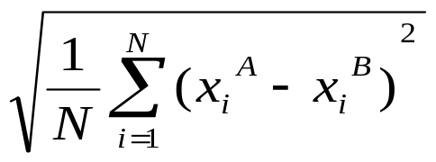
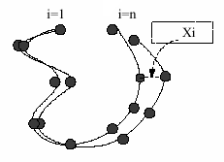
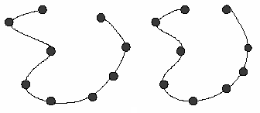
Minimize the RMSD
we only consider those pairs of atoms that are aligned within T Å. The value we selected for T was 3 Å.

Slide 13
Methods (cont.)
Step 3: Core Superposition
  We implemented the following two tests to determine whether or not an atom is well aligned:
  1. For every atom in protein A, find the nearest atom in protein B,
  and for every atom in protein B, find the nearest atom in
  protein A (considering only atoms that are aligned within T Å).
  Select all pairs of atoms that find each other as nearest
  neighbors.
  2. Delete all pairs of atoms in the list obtained from step 1 that
  violate co-linearity; i.e., select the maximum number of
  aligned pairs that are in order in both protein A and B and
  ignore the rest.
A
i
p
B

Slide 14
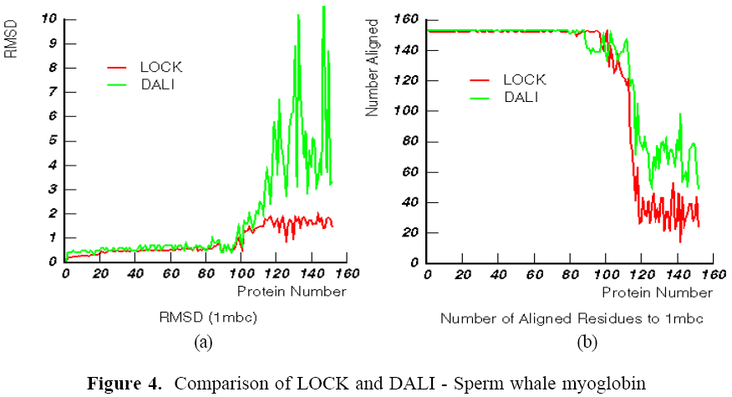
Result
We compared our structural superposition algorithm, LOCK, to that of Holm and Sander. Their algorithm, DALI, was used to construct the Families of Structurally Similar Proteins (FSSP) database (Holm and Sander, 1996b).
Sperm whale myoglobin (1mbc)
153 residues, all alpha
Number of structural neighbors 152
Time for search: 2 min, 27 sec
The number of the protein in the list
of structural neighbors reported by
FSSP.

Slide 15
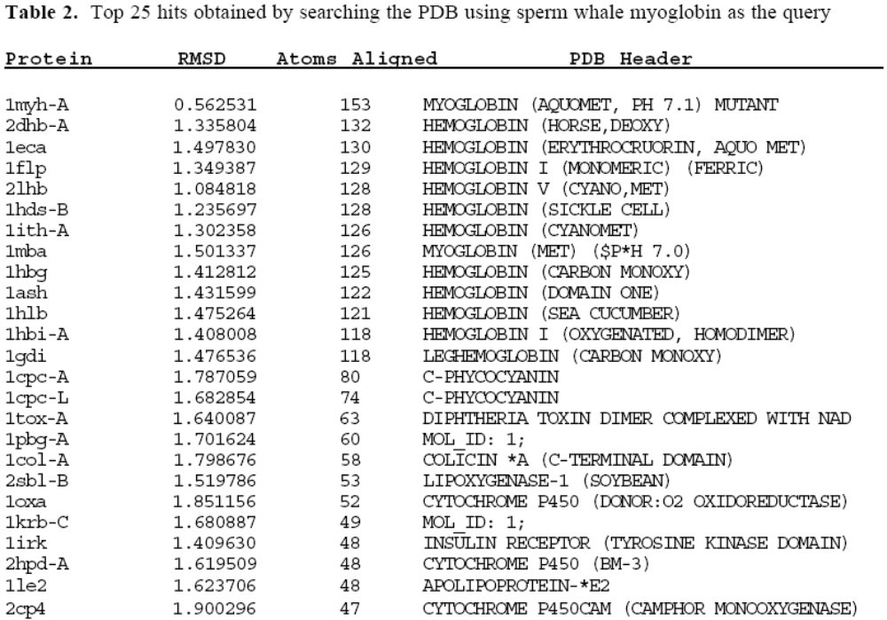
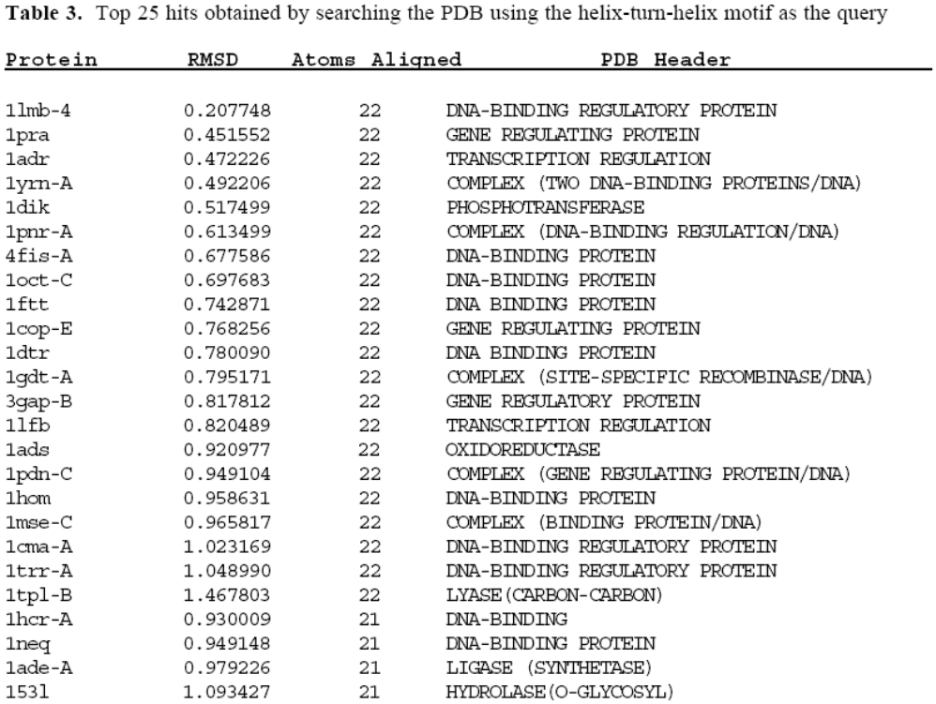
Result (cont.)
We also tested our program by performing a series of PDB searches using both complete proteins and small structural motifs as queries.

